Slide 1
The Impact of Social Media on Sex and Relationships
Leanna Wolfe, Ph.D.

Slide 2
Dating Before the Internet
Dances, Parties, Friends
Getting Fixed Up
Matchmakers
Arranged Marriages
Magazine and Newspaper Personals
Slow replies with handwritten letters and printed photographs
Phone/Chat Dating
Fees for men; free for ladies

Slide 3
Online Dating
Matching becomes so efficient and the process so enjoyable that marriage could become uninteresting
Threaten Dreams of Monogamy by offering up endless possible others to choose from
Perusing more interesting than settling with one
Easy to land a first date…and ever so difficult to get to a second one

Slide 4
Match.com

Slide 5
Plenty of Fish Free Online Dating

Slide 6
OK Cupid…Offers More Dates One “Might Like”

Slide 7
Dating Apps

Slide 8
Gay Men’s Dating App

Slide 9
What Dating Apps Provide
Immediate Gratification Hookups
For “this moment”
Quick Connection
No Waiting
GPS Enabled
Immediate Proximity

Slide 10
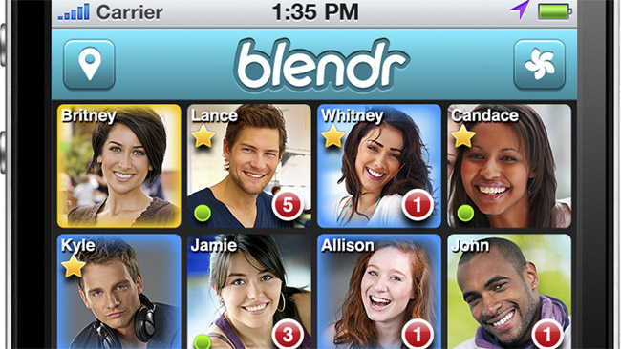
More Dating Apps

Slide 11
Lesbian Dating App

Slide 12
Craigslist Personals

Slide 13
M4M – Craigslist Spokane
<<< prev1 - 100 of 419 next >
Mar 13 Young hung top here 19 (N. Spokane) pic
Mar 13 lets play 35 (north spokane/perry st) pic
Mar 13 seeking long term friend and playmate (spo)
Mar 13 Bi Oral/Top seeking Bi Oral/Bottom 35 (valley)
Mar 13 Bicurious bottom looking for a gentleman top (Downtown)
Mar 13 Hiking Partner wanted 66 (CDA)
Mar 13 Bottom/Masc/Seeks LTR/Fishing/Camping/Sports 45 (Cheney/Spokane/AH)
Mar 13 Want To Swallow A Load From A Twink Boy 34 (Spokane) pic
Mar 13 Dad LoImmediate Gratification Hookups
oking For His Twink Boy Who Wants To Suck,Jo,Cum, and More - m4m 45 (spokane) pic
Mar 13 Private Glory Hole Open All Day/Night - m4m 30 (Nw blvd spokane)
Mar 13 Male seeking LTR. (Spokane) pic
Mar 13 Deepthroat on the Big Screen... - m4m (Spokane) pic
Mar 13 looking to date 33 (spo valley)
Mar 13 looking for a bottom at the hotels (d

Slide 14
Daddy – Boy Craigslist Ads
<<< prev1 - 13 next >
Mar 13 Dad Looking For His Twink Boy Who Wants To Suck,Jo,Cum, and More - m4m 45 (spokane) pic
Mar 4 Daddy Looking For A Twink Boy Who Wants To Play Tonight Till 11PM - m4m 45 (West spokane) pic
Mar 3 Dad Looking For His Twink Boy Who Wants To Suck,Jo,Cum, More Tonight - m4m 45 (spokane) pic
Feb 28 Daddy Looking For A Twink Boy Who Wants To Play Tonight Till 1AM - m4m 45 (West spokane) pic
Feb 26 Daddy's Pervy "little" boy 20 (Airway Hights)
Feb 26 Bottom boy and urinal 43 (spokane)
Feb 22 cute bottom boi wanted 51 (spokane)
Feb 20 This boy wants his daddy 20 (Airway Heights) pic
Feb 19 Pervy Daddys Boy Fist Timer 20 (Airway Hights) pic
Feb 16 Need a daddy to worship 26 (spokane)
Feb 7 Horny Daddy Looking To Experiment With His Horny Twink Son Till 12AM - m4m 45 (West Spokane) pic
Feb 5 Horny Daddy Looking To Experiment With His Horny Twink Son Till 1AM - m4m 45 (West Spokane)

Slide 15
A Brief History of Sexting

Slide 16
Erotic Cave Paintings

Slide 17
Ancient Hindu Erotica

Slide 18
Calculator Spells “BOOBS”

Slide 19
Beepers for Erotically Coded Data

Slide 20
Polaroid Cameras (No more censorship of personal photos)

Slide 21
Picture Phones!!

Slide 22
Tiger Woods’ 2009 Sexting Scandal

Slide 23
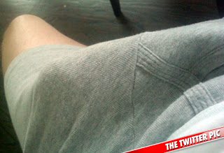
Anthony Weiner’s Politics of Sexting

Slide 24
Why a Text/Sext is So Interesting
Personal
Kicks up dopamine levels
Can co-create a personal pornography
Conveys Immediacy and Importance
Email has become largely impersonal spam
Transmits information efficiently
Locations, Times, Particulars
Easy to include photos
Especially fun and suggestive one
Last bastion for originality
Assistants can be hired to tweet and post to Facebook, but for most of us texting is our own business

Slide 25
When a Text is More Interesting…

Slide 26
Sexting on a Date

Slide 27
Texting in Bed

Slide 28
Fantasy Chat
Foreplay
Seduction
Assessment
Flirtation
Exaggerations
Distortions
Entertainment
A Co-Created Pornography
End in itself

Slide 29
Sext Fantasy Role Play
Discuss activities that could happen
Some never will…just shared fantasy
Safe arena to explore and tantalize
Share suggestive photos
Co-create possible moments and scenes
Discover common interests
Uncover new possibilities

Slide 30
Seduction Sexting
Where would you like to be kissed?
Hmmmmm my lips…and my cock
Where will you kiss me?
Your lips, your nipples and your pussy☺
Ahhh. I wish you were nearby☺

Slide 31
Erotic Negotiation Sexting
Will you tie me up?
Yes! And then have my way with you!!
I’m creaming with excitement☺
I can’t wait to kiss you all over
Is it okay if I scream really loud?
Baby, I want to hear you scream and cum all over me

Slide 32
her
her chronicles a passionate relationship with an Operating System which is ultimately carrying on equal intimacy with hundreds of other yearning souls

Slide 33
In Relationship with an Operating System…

Slide 34
The Downsides
Loss of in-person social skills
Less need to be articulate, focused or even interested
“Sup” and “Hey” don’t require much interest or initiative
Pressure to respond quickly to texts
Little space to contemplate and sincerely reflect and share

Slide 35
The Upsides
The Internet can be an accessible venue for busy and shy people to meet possible partners
Easy access to people around the world
Easy contact with intimates while travelling
Depending on the skills of those texting – much can in fact be discussed.

